Slide 1
A PROSPECTIVE OBSERVATIONAL STUDY ON RISK ASSESSMENT AND MOTHER’S KNOWLEDGE ON NEONATAL JAUNDICE
GARGI MONDAL (17BU1T0007)
KUNCHE SANDHYA (17BU1T0010)
MANCHALA RAVI TEJA (17BU1T0016)
RAJANALA RATHNAKAR (17BU1T0021)
UNDER THE ESTEEMED GUIDANCE OF
Dr. UDAY KUMAR KANDURI, MBBS, DCH, DNB, MRCPCH(UK), ESI HOSPITAL, NACHARAM
Dr. GABRIELA KEERTHANA GONDHI, Pharm.D, MBA-HHSM, MLRIP

Slide 2
WHY THIS STUDY?

Slide 3
INTRODUCTION

Slide 4
INTRODUCTION
Neonatal jaundice is yellowish discoloration of skin, conjunctiva and sclera due to elevated serum or plasma bilirubin in the newborn period. It is typically a transient and mild event.
About 50 percent of term and 80 percent of preterm infants develop jaundice in the first week of life.
Elevated bilirubin levels are toxic for development of Central nervous system and causes neurological and behavioral impairment.

Slide 5
ETIOLOGY
Physiological jaundice
It occurs due to differences in bilirubin metabolism as there is increased production of bilirubin due to decreased lifespan of red blood cells, decreased bilirubin clearance due to deficiency of uridine diphosphate glucuronosyltransferase (UGT) and increased enterohepatic circulation.
Pathological jaundice
It is observed on the first day of birth. There is a rapid increase in the bilirubin which can be due to immune mediated hemolysis as ABO and Rhesus incompatibility, non-immune mediated such as cephalohematoma, RBC membrane defects. The increase in the serum bilirubin levels is higher than 5mg/dl/day and presence of this for greater than 14 days is considered as pathological jaundice.
Rhesus hemolytic disease
It is caused from maternal red cell alloimmunization when the baby born is Rh-positive to a Rh-negative mother and Rh-positive father. Here the mother’s immunoglobulin antibodies i.e., IgG crosses the placenta and enters the fetal circulation causing several symptoms of mild to severe hemolytic anemia.
G6PD deficiency
Infants with family history of G6PD deficiency has greater chances of severe jaundice. It is the deficiency of an enzyme in RBCs which plays a vital role in hexose monophosphate pathway.
Neonatal jaundice is differentiated into several types.

Slide 6
RISK FACTORS
MATERNAL
Hypertension
Premature rupture membranes
NEONATAL
Blood group incompatibilities
Diabetes mellitus
Preeclampsia
Vaginal bleeding
Improper lactation
Breast problems
Blood group incompatibilities
Type of delivery
Term of delivery
Sex
Weight
Gestational age
Cephalohematoma
Difficulty in feeding
Gastro intestinal obstruction
Sepsis
Hypothyroidism
G6PD deficiency
Hemolytic anemia
Previous sibling with significant jaundice

Slide 7
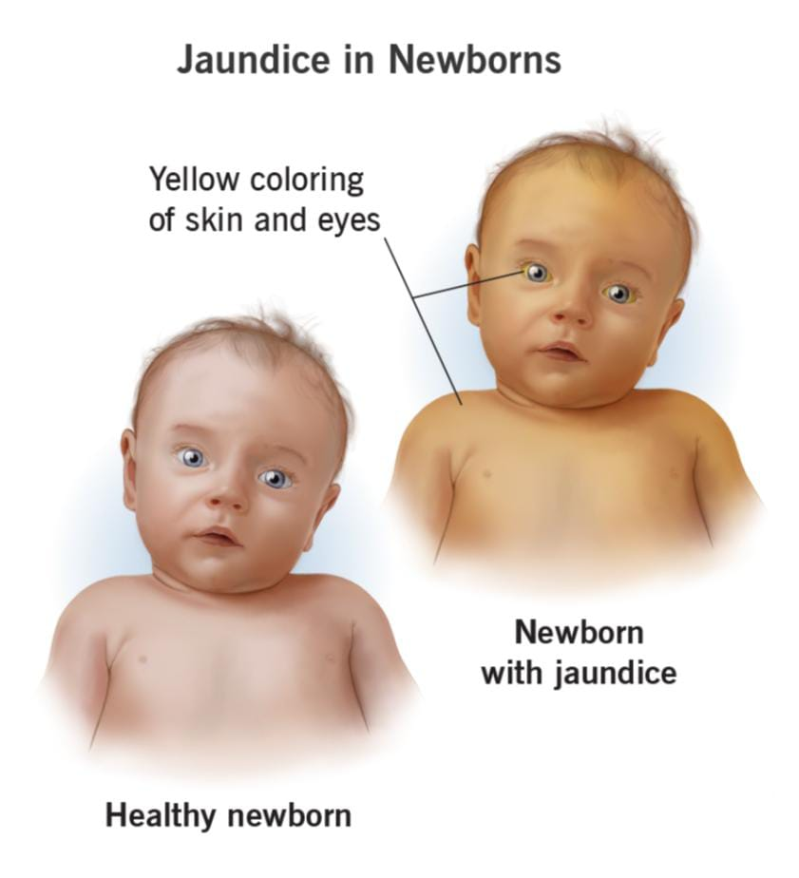
SIGNS AND SYMPTOMS
Yellowing in the sclera, soles of feet, palms and inside of their mouth.
The neonate will be sleepy.
The newborn may also not will to feed.
Newborn have dark, yellow urine and pale stools.

Slide 8
DIAGNOSIS
Visual examination: The diagnosis of neonatal jaundice varies during the 1st weeks of birth because visually all neonates have decrease in conjugation and excretion rate. The visual examination should be done including sclerae, blanched skin of limbs, torso, forehead and gums within 48 hours of birth under bright or natural light.The staining of skin takes place in cephalo caudal direction. By using a digital pressure, the doctor should pale the skin and observe the subcutaneous tissue and underlying color of skin. If the neonate is observed to have yellow skin beyond thighs, then immediately the bilirubin levels should be checked.
Measuring direct bilirubin: The level of jaundice is based on values of direct bilirubin >35 μmol/L or more than 15% of total serum bilirubin.
Stool examination: The stool color is to be checked for the neonates along with the bilirubin levels. Pale color stools are observed if the neonate is having jaundice.

Slide 9
TREATMENT
Phototherapy
Exchange transfusion
Phenobaritone
Pharmacological therapy
Intravenous immunoglobulins
Mettaloporphyrins

Slide 10
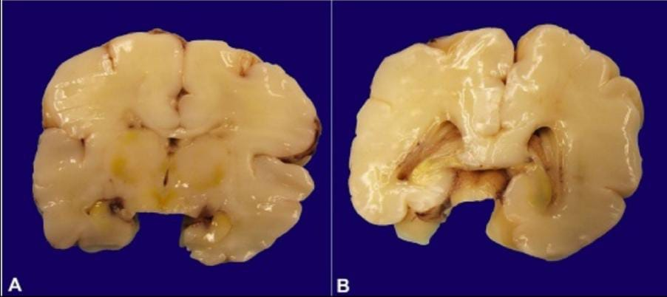
COMPLICATIONS
Complications are rare but are serious which include
Cerebral Palsy
Deafness
Kernicterus

Slide 11
AWARENESS ON NEONATAL JAUNDICDE
Neonatal jaundice is one of the most common disorders resulting in severe neurological sequelae globally and nationally.
Timely and proper management to reduce these complications depends on the level of the mother’s knowledge about neonatal jaundice.
Early detection and treatment are the key elements to prevent severe neonatal jaundice.
An understanding of the knowledge level in a specific population can help to identify the gaps and target areas for intervention.

Slide 12
LITERATURE REVIEW

Slide 13
LITERATURE REVIEW
Murekatete C, et al. have performed retrospective cross-sectional design in district hospital in Rwanda titled “Neonatal Jaundice risk factors at a District Hospital in Rwanda'' published in Rwanda Journal of Medicine and Health Sciences, 2020, which states that Hyperbilirubinemia can cause life-long brain damage so screening and prompt treatment is necessary.
The goal of the study was to check neonatal jaundice risk factors in newborns. 210 files were selected by stratified proportional sampling for the years 2016-2018.
The study discovered that Gestational age, blood group incompatibilities, Birth weight, neonatal gender, infections, prematurity and C-section were associated with neonatal jaundice.

Slide 14
2. Goodman, et al. have performed a descriptive cross - sectional study in Mosan - Okunola community, Lagos, Nigeria titled, “Neonatal Jaundice: knowledge, attitude and practices of mothers in Mosan - Okunola community, Lagos, Nigeria” published in Nigerian postgraduate medical journal, 2015, which states that there were many misconceptions about neonatal jaundice where knowledge gaps need to be addressed and filled.
The study intended to judge the knowledge and preventive practices of mothers in the Mosan - Okunola community.
This study included 358 women and found that the awareness of neonatal jaundice was 75.4%. If the baby developed neonatal jaundice 90.4% mothers had willingness to take the baby to hospital.
The study also found out that the awareness was high but the knowledge about causes, complications and danger signs was low.

Slide 15
3. Asmamaw Demis, et al. have performed a cross-sectional study in Amhara region, Ethiopia, titled “Knowledge on neonatal jaundice and its associated factors among mothers in north Ethiopia: a facility-based cross-sectional study” published in BMJ open, 2021, which states that poor decision and slow seeking of medical care by mothers can be due to lack of information or wrong information.
The intention of the study was to determine mother’s knowledge and associated factors on neonatal jaundice in Northern Ethiopia.
The mothers who had a favorable approach towards neonatal jaundice have good knowledge. mother’s attitude on Neonatal jaundice, Antenatal care follow up, child history of Neonatal jaundice, current child history of Neonatal jaundice, and residence were variables that had a significant association with mother’s knowledge on Neonatal jaundice.
The study inferred that awareness about prevention can be increased by conducting education programs on neonatal jaundice.

Slide 16
4. Hassan Boskabadi, et al. have performed a systematic review, titled “Evaluation of maternal risk factors in neonatal hyperbilirubinemia” published in archives of Iranian medicine,2020, which states that controlling jaundice can be effective if the predisposing factors for neonatal jaundice are identified.
The study systematically reviewed maternal risk factors in neonatal jaundice. This study took 17 related articles from different databases.
The study concluded with list of maternal risk factors includes pregnancy problems(prematurity, premature rupture of membrane, negative), maternal diseases(hypertension, diabetes, preeclampsia), labor problems(type of delivery, cephalohematoma, delayed labor, complications), breastfeeding problems(breast problems, reduced feeding) and other factors like maternal age, first delivery, abortion history.

Slide 17
5. Egube BA, et al. have performed a descriptive cross-sectional study in ante-natal clinic of University of Benin teaching hospital in Benin city, Nigeria, titled “Neonatal jaundice and its management: knowledge, attitude and practice among expectant mothers attending antenatal clinic at university of Benin teaching hospital” Benin city, Nigeria published in Nigerian journal of clinical practice, 2013, which states that one of the major causes for neonatal mortality is neonatal jaundice.
Neonatal jaundice very high in sub-Saharan Africa, Asia and Latin America.
The study included 389 expectant mothers attended ante-natal clinic in 2005.The study learned that 85.9% knew about neonatal jaundice, 77.4% knew how to detect neonatal jaundice. 71.7% knew of treatment of neonatal jaundice, 67% knew the complication.
The study stated that knowledge level about Neonatal jaundice was influenced by the education level and previous babies with Neonatal jaundice.

Slide 18
AIMS AND OBJECTIVES

Slide 19
AIMS AND OBJECTIVES
AIM
OBJECTIVES
To assess the risk of jaundice in neonates.
To assess mother’s knowledge on neonatal jaundice.
To compare full term with pre term neonates both having neonatal jaundice.
To educate mothers regarding neonatal jaundice and increase their awareness.
To assess the risk and mother’s knowledge on neonatal jaundice.

Slide 20
PLAN OF WORK

Slide 21
PLAN OF WORK
Selecting the department of study, topic and review relevant scientific literature
Establishing title, aim and objectives of the study
Getting approval from the head of institution and hospital authorities
Designing the data collection form
Selection of patients based on inclusion and exclusion criteria
Getting the consent from patient
Tabulating the data, analyzing using statistical tools and submitting the report

Slide 22
METHODOLOGY

Slide 23
METHODOLOGY
STUDY DESIGN
This study design is prospective observational study.
STUDY SITE
The study will be conducted in IN PATIENT and OUT PATIENT facilities of Department of Pediatrics, ESI Hospital, a 500 bedded tertiary Care Hospital located in Nacharam, Hyderabad, Telangana.
STUDY PERIOD AND DURATION
The study period is of 6 months i.e., from November 2021 to April 2022.
STUDY POPULATION
106 subjects were recruited in the study, 11 subjects we excluded. Therefore, we completed the study with 95 subjects.

Slide 24
SELECTION OF SUBJECTS AND RECRUITMENT PROCEDURE
The study subjects will be selected from Department of Pediatrics based on the following inclusion and exclusion criteria.
INCLUSION CRITERIA:
All the babies born during the study period along with their mothers.
Babies of age ≤28 days.
Mothers who can understand, answer the questions and willing to participate.
EXCLUSION CRITERIA:
Babies of age > 28 days.
Babies who are sick and ventilated.
Mothers who are not willing to participate.
Mothers who can’t give complete information.

Slide 25
DROP OUTS:
Out of 106 subjects recruited in the study, 11 subjects we excluded due to incomplete data. Therefore, we completed the study with 95 subjects.
PATIENT DATA COLLECTION FORM:
A Suitable patient data collection form was prepared with the help of a physician. It includes patient demographic data (name, age, gender, weight, blood group, pre/full term, medical history) mother’s demographic data (name, age, weight, blood group, lactation, personal history, medical and medication history, knowledge about jaundice).

Slide 26
STATISTICAL TOOLS:
We used Microsoft excel to perform chi-square test and unpaired t-test. We calculated mean, standard deviation and p value using excel.
PATIENT COUNSELLING:
All the mothers included in the study were given education about neonatal jaundice. The counselling session was 5-10 minutes. The mothers were counselled in a language they understand (Telugu, Hindi or English).
They were counselled regarding causes, signs and symptoms, complications and prevention of neonatal jaundice.
Patient information leaflet was given to the mothers at the end of the counselling session.

Slide 27

QUESTIONARE FOR RISK FACTORS

Slide 28
QUESTIONARE FOR MOTHER’S KNOWLEDGE

Slide 29
RESULTS

Slide 30
RESULTS
DISTRIBUTION OF STUDY POPULATION(MOTHERS) BASED ON AGE

Slide 31
DISTRIBUTION OF STUDY POPULATION(NEONATES) BASED ON SEX

Slide 32
DISTRIBUTION OF STUDY POPULATION(NEONATES) BASED ON BIRTH WEIGHT AND PRE-TERM OR FULL TERM

Slide 33
DISTRIBUTION OF STUDY POPULATION BASED ON RESIDENCY

Slide 34
DISTRIBUTION OF STUDY POPULATION(MOTHERS) BASED ON THEIR MARITAL LIFE

Slide 35
DISTRIBUTION OF STUDY POPULATION(MOTHERS) BASED ON EDUCATION QUALIFICATION

Slide 36
DISTRIBUTION OF STUDY POPULATION(MOTHERS) BASED ON TYPE OF DELIVERY

Slide 37
DISTRIBUTION OF STUDY POPULATION(NEONATES) BASED ON DURATION OF JAUNDICE

Slide 38
DISTRIBUTION OF STUDY POPULATION(MOTHERS) BASED ON RISK FACTORS RELATED TO MOTHER

Slide 39
DISTRIBUTION OF STUDY POPULATION(NEONATES) BASED ON RISK FACTORS RELATED TO NEONATES

Slide 40
DISTRIBUTION OF STUDY POPULATION(NEONATES) BASED ON BILIRUBIN LEVELS ON DAY OF ADMISSION

Slide 41
DISTRIBUTION OF STUDY POPULATION(NEONATES) BASED ON BILIRUBIN LEVELS ON DAY OF DISCHARGE

Slide 42
KNOWLEDGE OF MOTHERS ON NEONATAL JAUNDICE

Slide 43
KNOWLEDGE OF MOTHERS ABOUT SIGNS AND SYMPTOMS OF NEONATAL JAUNDICE

Slide 44
KNOWLEDGE OF MOTHERS ON TREATMENT OF NEONATAL JAUNDICE

Slide 45
SATISTICAL DATA
Parameter | Factors | P value
Mother’s knowledge | Age | 0.221782
 | Locality | 0.78322
 | Primiparity | 0.000167
 | Education | 0.000736
Total serum bilirubin with maternal risk factors | No feeding during 1st hour after birth | 0.906782
 | Pre mature rupture of membrane | 0.136583
 | Marital life | 0.806963
 | Gestational diabetes | 0.000131
 | Difficulty in feeding | 0.079864
Total serum bilirubin with neonatal risk factors | Sex | 0.570795
 | Rh incompatibility | 0.368256
 | ABO incompatibility | 0.456893
 | Previous siblings with jaundice | 0.061783
 | Term of pregnancy | 0.181818
 | sepsis | 0.116545

Slide 46
discussion

Slide 47
DISCUSSION
DISTRIBUTION OF STUDY POPULATION (MOTHERS AND NEONATES) BASED ON DEMOGRAPHIC DETAILS
The most numbers of study subjects are in 25-29 age groups with 45.26% of the total study population. The least number of study subjects are in 35-39 age groups with 8.42% of the total study population. The mean age of the mothers was found to be 27.610± 4.354.
During the study period, it was found that 46 study subjects have completed their education till graduation, 9 subjects till post-graduation, 13 completed till intermediate, 2 of them completed their diploma and 25 subjects completed their schooling.

Slide 48
DISTRIBUTION OF STUDY POPULATION BASED ON BIRTH WEIGHT AND PRE-TERM OR FULL TERM
In the total study population, the majority of full-term neonates had birth weight of 3-3.2 kgs and least number of study subjects were 2.2-2.4 kgs. In pre term neonates, majority of study subjects had birth weight of 2.8- 3 kgs and least number of them had birthweight of 2-2.2 kgs. The mean birth weight of full-term neonates is 2.855± 0.396 and in pre term is 2.857± 0.398.
In a systemic review performed by Hassan Boskabadi, et al. have found that prematurity was associated with neonatal jaundice.

Slide 49
DISTRIBUTION OF STUDY POPULATION BASED ON RISK FACTORS RELATED TO MOTHER
The most common risk factor related to mothers was found to be no feeding during 1st hour after delivery (64.21%) and the least common risk factor was found to be preeclampsia (1.05%).
Similar study was performed by Hassan Boskabadi, et al. The study concluded with list of maternal risk factors includes pregnancy problems(prematurity, premature rupture of membrane, negative maternal Rh), maternal diseases(hypertension, diabetes, preeclampsia, gestational infections), labor problems(type of delivery, cephalohematoma, place of delivery, delayed labor, delivery trauma, complications), breastfeeding problems(breast problems, reduced feeding, inappropriate breastfeeding technique) and other factors like maternal age, first delivery, abortion history.

Slide 50
DISTRIBUTION OF STUDY POPULATION BASED ON RISK FACTORS RELATED TO NEONATES
The most common risk factor in both full term and pre term neonates was male sex with percentages of 55.55% and 43.75% respectively. The least common risk factor in full term neonates was sepsis and Rh incompatibility (6.34%) and in pre term neonates was Rh incompatibility (6.25%).
Similar studies were performed by Murekatete C, et al. This study found that Gestational age, ABO and other blood group incompatibilities, Birth weight, neonatal gender, infections, prematurity and C-section were associated with neonatal jaundice.^{[11]}
In another study performed by Asmamaw demis bizureh, et al. found out prolonged labour, low birth weight, sepsis, birth asphyxia, hypothermia, sex were risk factors of Neonatal jaundice.^{[23]}
Study performed by Stephanee campbell wagemann, patricia mena nannig found out male sex, prematurity, excessive weight loss and blood group incompatibility were the risk factors for severe hyperbilirubinemia.

Slide 51
DISTRIBUTION OF STUDY POPULATION(NEONATES) BASED ON BILIRUBIN LEVELS ON DAY OF ADMISSION
During the study, majority of full-term neonates had bilirubin levels of 12-14mg/dl and pre-term neonates had bilirubin levels of 12-13mg/dl on day of admission. Least number of full-term neonates had bilirubin levels of 10-11mg/dl and 16-17mg/dl and pre-term neonates had bilirubin levels of 16-17mg/dl on day of admission.
The average total serum bilirubin on day of admission was found to be 13.189± 1.407.
DISTRIBUTION OF STUDY POPULATION(NEONATES) BASED ON BILIRUBIN LEVELS ON DAY OF DISCHARGE
During the study, majority of full-term neonates had bilirubin levels of 7-8mg/dl and pre-term neonates had bilirubin levels of 9-10mg/dl on day of discharge.
Least number of full-term neonates had bilirubin levels of 3-4mg/dl and pre-term neonates had bilirubin levels of 3-4 mg/dl and 11-12mg/dl on day of discharge.
The average total serum bilirubin on day of discharge was found to be 8.015± 1.915.

Slide 52
KNOWLEDGE OF MOTHERS ON NEONATAL JAUNDICE
In the total study population 71.58% of mothers have the knowledge of neonatal jaundice, 57.89% have the knowledge of treatment for neonatal jaundice and only 21.05% know the seriousness of jaundice.
Similar studies were performed by Goodman et.al, Asmamaw Demis et.al, and Egube BA et.al, the studies found that the awareness of neonatal jaundice among mothers is 75.4%, 39.2% and 85.9% respectively.
KNOWLEDGE OF MOTHERS ABOUT SIGNS AND SYMPTOMS OF NEONATAL JAUNDICE
During the study the highest number of mothers answered yellow eyes (37.89%) as signs and symptoms of neonatal jaundice.
In a cross-sectional study by Amegan-Aho KH, et al. 72.6%of mothers knew at least any one sign or symptom.

Slide 53
KNOWLEDGE OF MOTHERS ON TREATMENT OF NEONATAL JAUNDICE
In the study population, majority of mothers knew the treatment for jaundice is sunlight (44.21%).
In a study performed by Amegan-Aho KH, et al. 52% of mothers know any one of treatment options.
ASSOCIATION OF MOTHER’S KNOWLEDGE WITH DIFFERENT MATERNAL FACTORS
We analysed mother’s knowledge with different maternal factors like age (p value = 0.221782), locality (p value= 0.78322), primiparity (p value =0.000167) and education (p value= 0.000736).
We got significant association of mother’s knowledge with primiparity and education.

Slide 54
ASSOCIATION OF TOTAL SERUM BILIRUBIN WITH MATERNAL RISK FACATORS FOR NEONATAL JAUNDICE
We analyzed association of total serum bilirubin with difficulty in feeding (p value =0.079864), no feeding during 1st hour after delivery (p value=0.906782), PROM (p value = 0.136583), marital life (p value=0.806963) and gestational diabetes (p value = 0.000131).
We got significant association between gestational diabetes in mother and total serum bilirubin in neonates.
ASSOCIATION OF TOTAL SERUM BILIRUBIN WITH NEONATAL RISK FACATORS FOR NEONATAL JAUNDICE
We analyzed association of total serum bilirubin with sex (p value = 0.570795), Rh incompatibility (p value=0.368256), ABO incompatibility (p value=0.456893), previous sibling with jaundice (p value = 0.061783), term of pregnancy (p value= 0.181818) and sepsis (p value= 0.116545).

Slide 55
conclusion

Slide 56
CONCLUSION
Neonatal jaundice is yellowish discoloration of skin, conjunctiva and sclera due to elevated serum or plasma bilirubin in the newborn period. In our study, the most common risk factor among mothers is no feeding during 1st hour after delivery and among neonates is male sex. Mothers had awareness about neonatal jaundice but knowledge regarding complications and treatment was low. The awareness about neonatal jaundice should be increased among mothers to identify, for early diagnosis and treatment. During our study, we helped mothers understand better about Neonatal jaundice.

Slide 57
LIMITATIONS

Slide 58
LIMITATIONS
Larger sample size is needed to draw proper conclusions which could have been possible with larger study period.
We got less sample size which is needed to give definite conclusions due to third wave of COVID-19.

Slide 59
ANNEXURES

Slide 60
ANNEXURES
ANNEXURE – I
ANNEXURE- II
ANNEXURE- III(A)
ANNEXURE- III(B)
ANNEXURE- III(C)

Slide 61
REFERENCE
Ansong-Assoku B, Shah SD, Ankola PA. Neonatal Jaundice. [Updated 2021 Oct 27]. In: StatPearls [Internet]. Treasure Island (FL): StatPearls Publishing; 2022 Jan. Available from: https://www.ncbi.nlm.nih.gov/books/NBK532930/
Ullah S, Rahman K, Hedayati M. Hyperbilirubinemia in neonates: types, causes, clinical examinations, preventive measures and treatments: a narrative review article. Iranian journal of public health. 2016 May;45(5):558. Available from: https://www.ncbi.nlm.nih.gov/pmc/articles/PMC4935699/
Cohen RS, Wong RJ, Stevenson DK. Understanding neonatal jaundice: a perspective on causation. Pediatrics & Neonatology. 2010 Jun 1;51(3):143-8.
Ng MC, How CH. When babies turn yellow. Singapore medical journal. 2015 Nov;56(11):599. Available from: https://www.ncbi.nlm.nih.gov/pmc/articles/PMC4656866/
Patel DR, Neelakantan M, Pandher K, Merrick J. Cerebral palsy in children: a clinical overview. Translational pediatrics. 2020 Feb;9(Suppl 1):S125. Available from: https://www.ncbi.nlm.nih.gov/pmc/articles/PMC4656866/
Hamza A. Kernicterus. Autopsy and Case Reports. 2019 Jan 14;9(1):0-. Available from: https://www.ncbi.nlm.nih.gov/pmc/articles/PMC6394357/
Sánchez-Gabriel MD, Castellanos JL, Fernández IB, Muñuzuri AP, Gracia SR, Campillo CW, López ES, Luna MS, Comisión de Estándares de la Sociedad Española de Neonatología. Guidelines for prevention, detection and management of hyperbilirubinaemia in newborns of 35 or more weeks of gestation. Anales de Pediatría (English Edition). 2017 Nov 1;87(5):294-e1. Available from: https://www.analesdepediatria.org/en-guidelines-for-prevention-detection-management-articulo-S234128791730162X
Woodgate P, Jardine LA. Neonatal jaundice: phototherapy. BMJ clinical evidence. 2015; 2015.Available from: https://www.ncbi.nlm.nih.gov/pmc/articles/PMC4440981/#!po=17.4051
Muchowski KE. Evaluation and treatment of neonatal hyperbilirubinemia. American family physician. 2014 Jun 1;89(11):873-8. Available from: https://www.aafp.org/afp/2014/0601/p873.html
Murekatete C, Muteteli C, Nsengiyumva R, Chiroda G. Neonatal Jaundice Risk Factors at a District Hospital in Rwanda. Rwanda Journal of Medicine and Health Sciences. 2020 Sep 7;3(2):204-13. Available from: ajol.info/index.php/rjmhs/article/view/199476 [accessed on 10th January 2022].

Slide 62
Goodman OO, Kehinde OA, Odugbemi BA, Femi-Adebayo TT, Odusanya OO. Neonatal jaundice: knowledge, attitude and practises of mothers in Mosan - Okunola community, Lagos, Nigeria. Nigerian Postgraduate Medical Journal. 2015 Jul 1; 22(3):158-163. Available from: npmj.org/article.asp?issn=1117-1936;year=2015;volume=22;issue=3;spage=158;epage=163;aulast=Goodman [accessed on 10th january 2022].
Demis A, Getie A, Wondmieneh A, Alemnew B, Gedefaw G. Knowledge on neonatal jaundice and its associated factors among mothers in northern Ethiopia: a facility-based cross-sectional study. BMJ open. 2021 Mar 1;11(3):e044390. Available from: https://www.ncbi.nlm.nih.gov/pmc/articles/PMC7942262/ [accessed on 20th january] 2.5
Boskabadi H, Rakhshani Zadeh F, Zakerhamidi M. Evaluation of maternal risk factors in neonatal hyperbilirubinemia. Archives of Iranian medicine. 2020 Feb 1;23(2):128-40. Available from: http://www.aimjournal.ir/Article/aim-6727 [accessed on 24th january 2022]
Egube BA, Ofili AN, Isara AR, Onakewhor JU. Neonatal jaundice and its management: knowledge, attitude, and practice among expectant mothers attending antenatal clinic at University of Benin Teaching Hospital, Benin City, Nigeria. Nigerian journal of clinical practice. 2013 May 27;16(2):188-94. Available from: https://www.njcponline.com/article.asp?issn=1119-3077;year=2013;volume=16;issue=2;spage=188;epage=194;aulast=Egube [Accessed on 25th January 2022]
Bizuneh AD, Alemnew B, Getie A, Wondmieneh A, Gedefaw G. Determinants of neonatal jaundice among neonates admitted to five referral hospitals in Amhara region, Northern Ethiopia: an unmatched case-control study. BMJ pediatrics open. 2020;4(1). Available from: https://www.ncbi.nlm.nih.gov/pmc/articles/PMC7511639/ [Accessed on 25th January 2022]
Wagemann SC, Nannig PM. Severe hyperbilirubinemia in newborns, risk factors and neurological outcomes. Rev. chil. pediatr. Santiago. 2019 Jun;90(3):267-74. Available from: https://www.scielo.cl/scielo.php?script=sci_arttext&pid=S0370-41062019005000702&lng=en&nrm=iso&tlng=en [Accessed on 26th January 2022]
Amegan-Aho KH, Segbefia CI, Glover ND, Ansa GA, Afaa TJ. Neonatal Jaundice: awareness, perception and preventive practices in expectant mothers. Ghana medical journal. 2019;53(4):267-72. Available from: https://www.ncbi.nlm.nih.gov/pmc/articles/PMC7036439/ [Accessed on 25th january 2022]

Slide 63
THANK YOU

